Slide 1

Accounts Payable Operations
Reach Out

Slide 2
Mohamed Sobhy
Instructor
Beshoy Essa
Ahmed Salah
Abdelrahman Baraka
Mohamed Said

Slide 3
Mohamed Sobhy
Instructor
Team Members
Abdelrahman Baraka
Ahmed Salah
Mohamed Said
Beshoy Essa

Slide 4
Objective:
Enable users to Add and manage vendor invoices, payments, and period closing activities in the Accounts
Payable module.

Slide 5
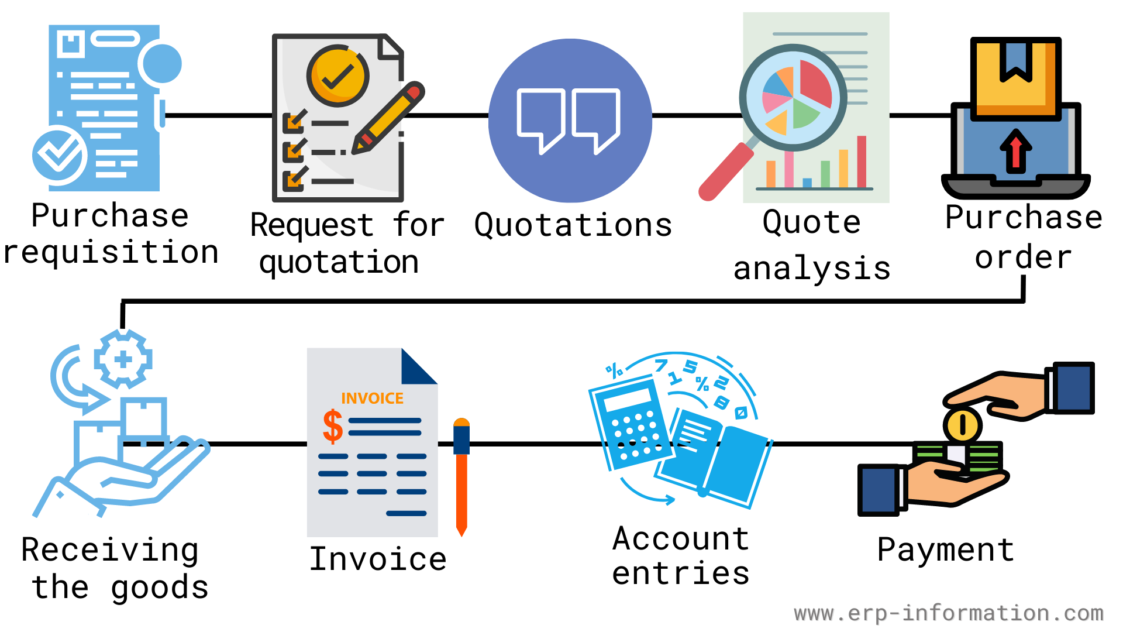
Procure to Pay Cycle

Slide 10




4
1
3
2
Content
PO
Matching
Create Invoice
Payments
Reports

Slide 11
1
2
3
4
Content
PO
Matching
Create Invoice
Payments
Reports

Slide 12
1
2
3
4
Content
PO
Matching
Create Invoice
Payments
Reports
Mohamed Said

Slide 13
1
2
3
4
Content
PO
Matching
Create Invoice
Payments
Reports
Mohamed Said
Beshoy Essa

Slide 14
1
2
3
4
Content
PO
Matching
Create Invoice
Payments
Reports
Mohamed Said
Beshoy Essa
Abdelrahman Baraka

Slide 15
1
2
3
4
Content
PO
Matching
Create Invoice
Payments
Reports
Mohamed Said
Beshoy Essa
Abdelrahman Baraka
Ahmed Salah

Slide 16
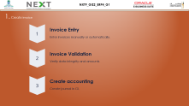
1.
4
1
3
2
Create Invoice
2.
PO Matching
Content
PO
Matching
Create Invoice
Payments
Reports
3.
Payments
4.
Reports

Slide 17

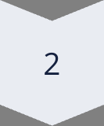
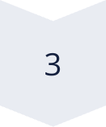
1.
Create Invoice
Invoice Entry
Enter invoices manually or automatically.
Invoice Validation
Verify data integrity and amounts.
Create accounting
Create journal in GL

Slide 18
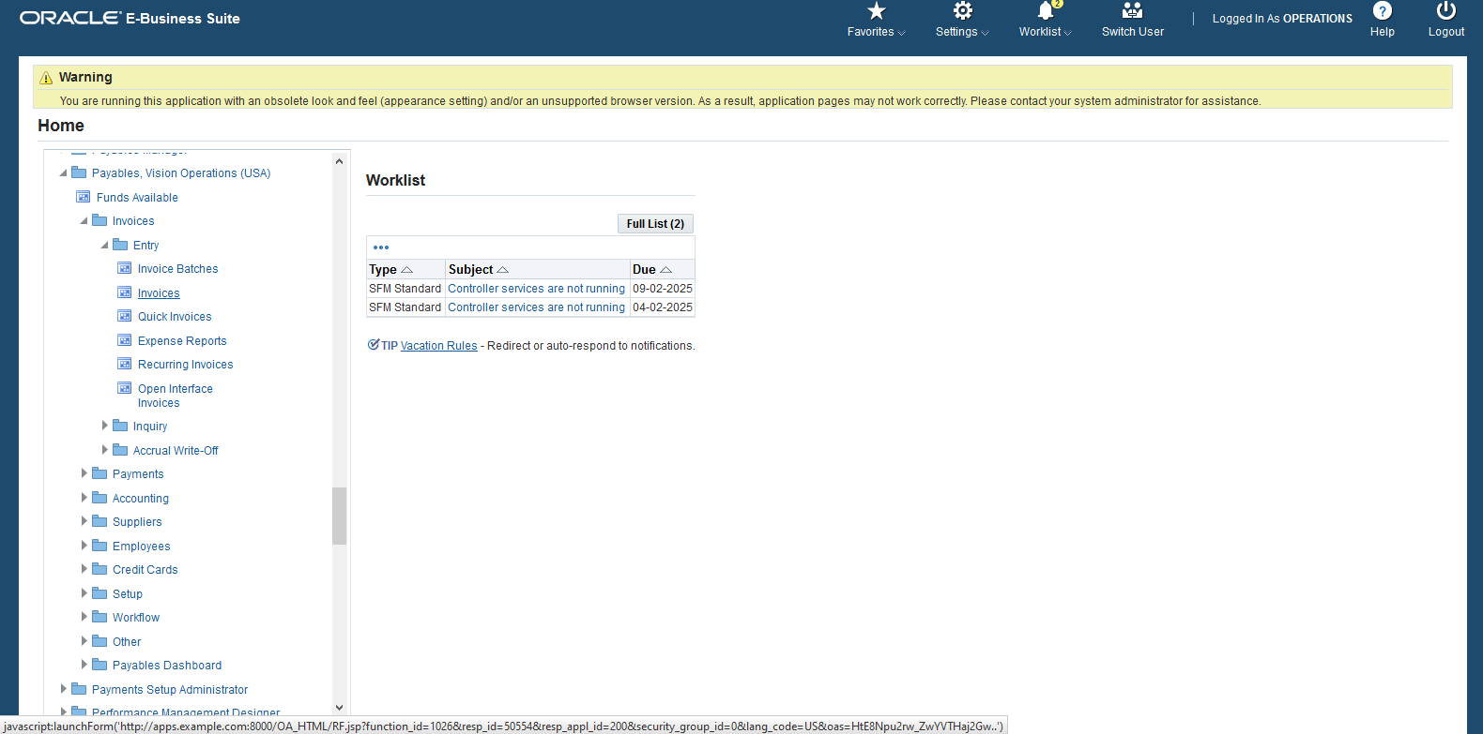
Invoice Entry
In Home Scree.
Select Payables Responsibility from the menu.
Navigate to Invoices or Payments based on the required action

Slide 19
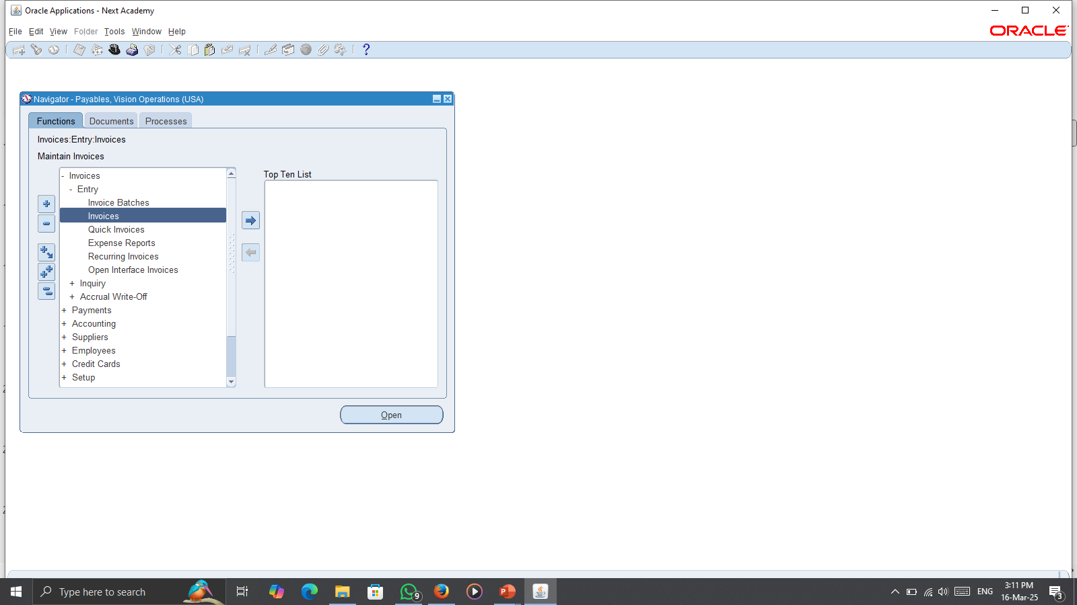
Invoice Entry
Go to the "Invoices" window.

Slide 20
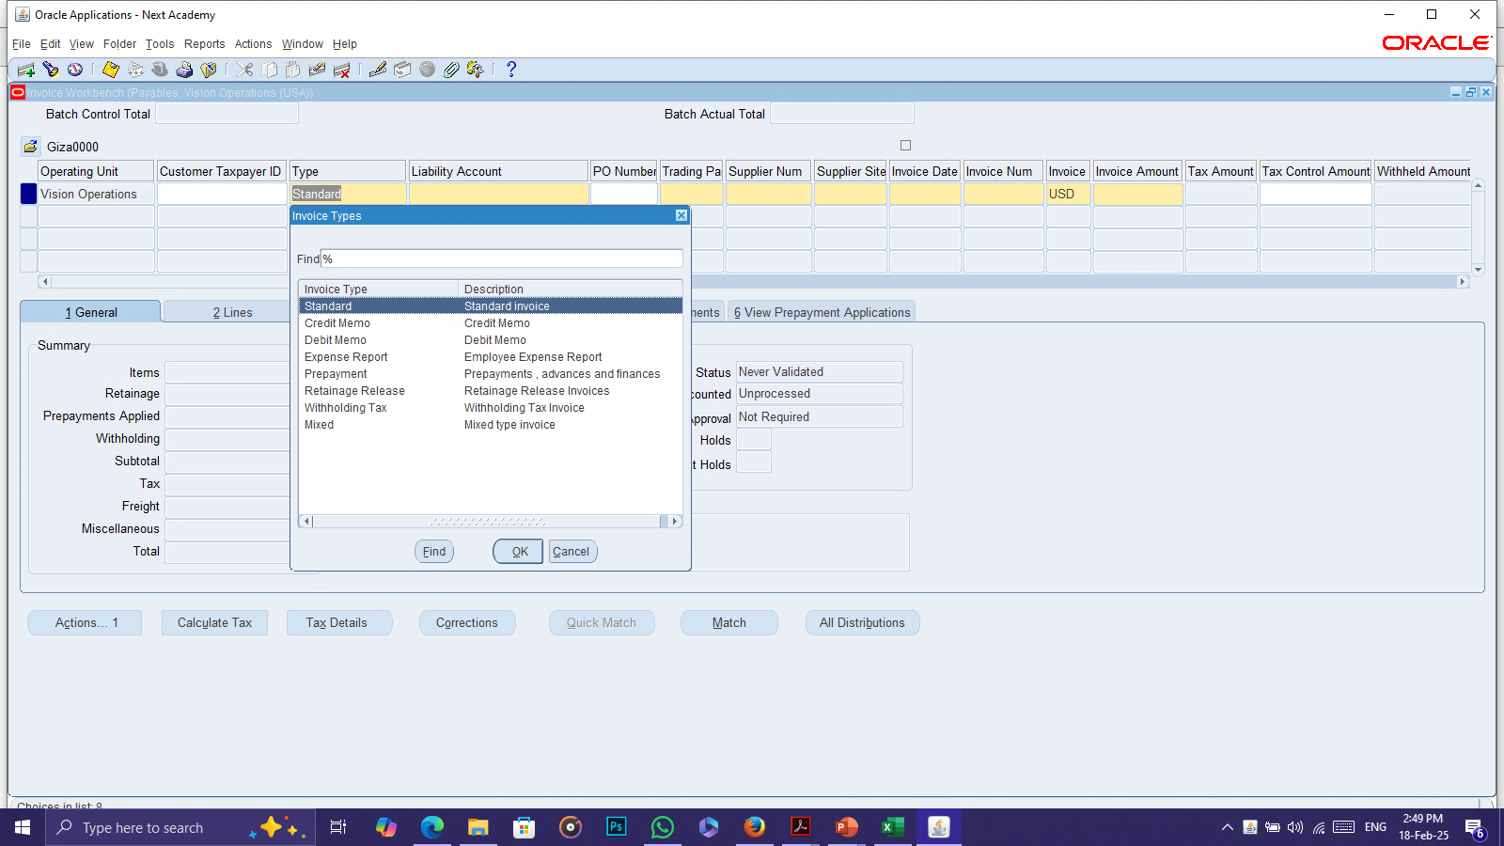
Invoice Entry
If invoice type is credit memo or debit memo, the value must be negative
And you may change payment term in supplier information
If invoice type is Prepayment, status after validation is unpaid and after we pay in full the status
changes to available (to be ready to use it in the invoices)

Slide 21
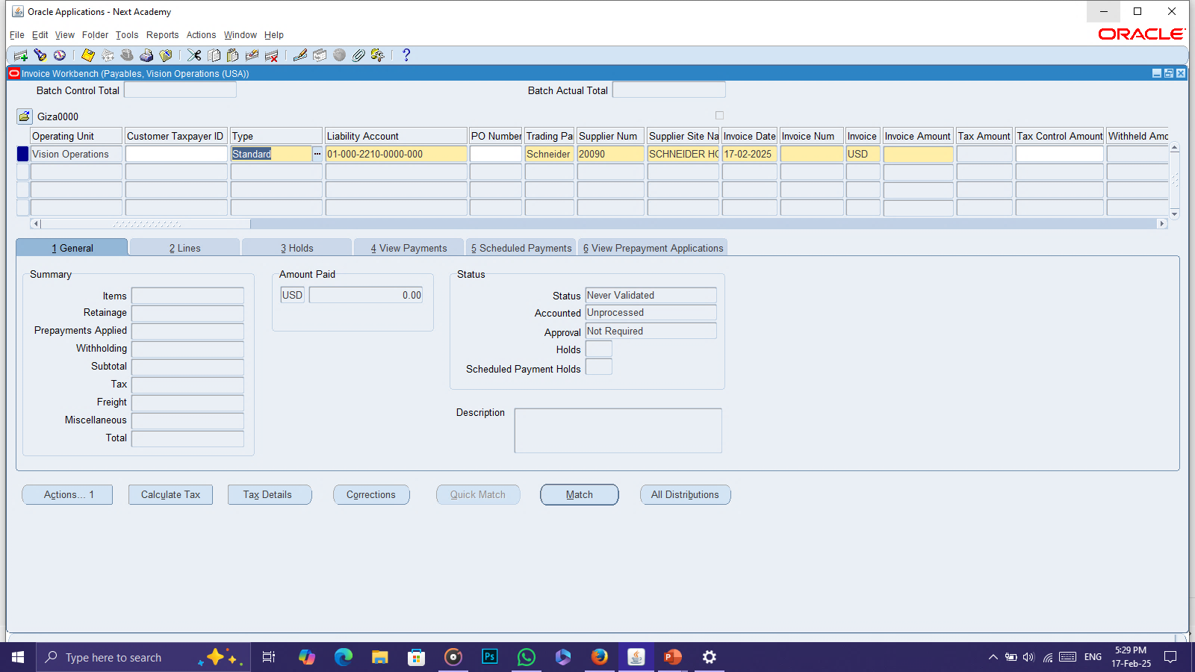
Invoice Entry
Add invoice type, supplier name or num, date, currency, invoice number, and amount.

Slide 22
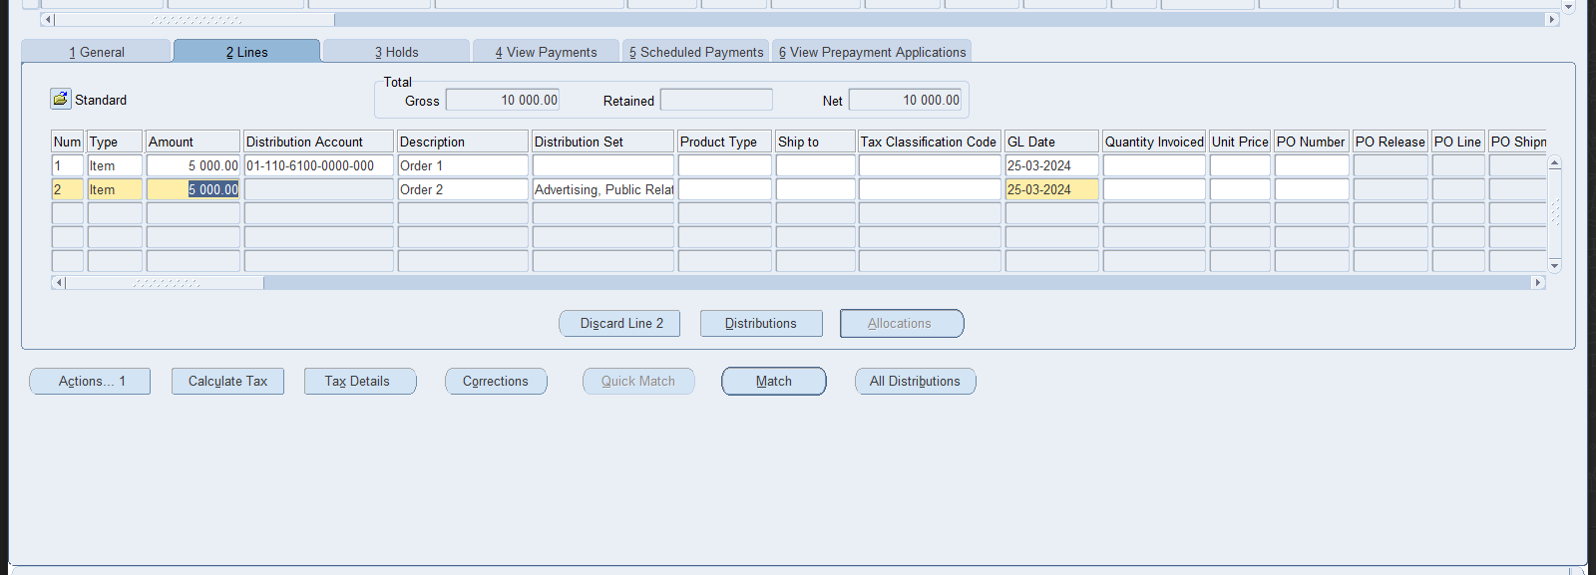
Invoice Entry
Enter invoice lines with amount and account or distribution set.

Slide 23
Invoice Entry
4- calculate taxes

Slide 24
Invoice Validation
Invoice Validation

Slide 25
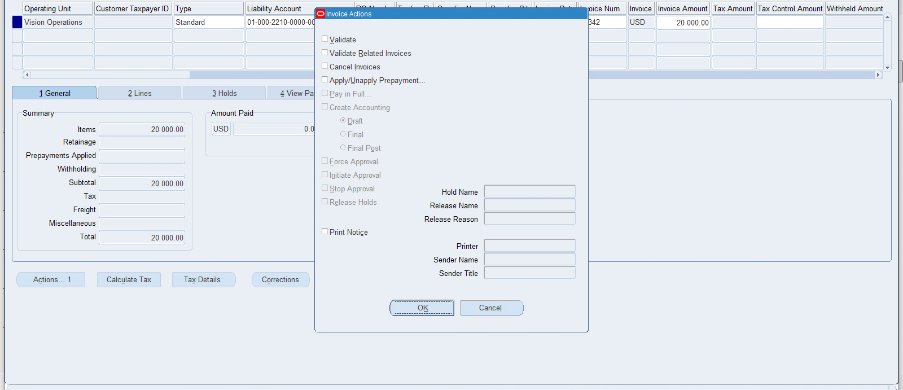
Invoice Validation
Invoice Validation

Slide 26
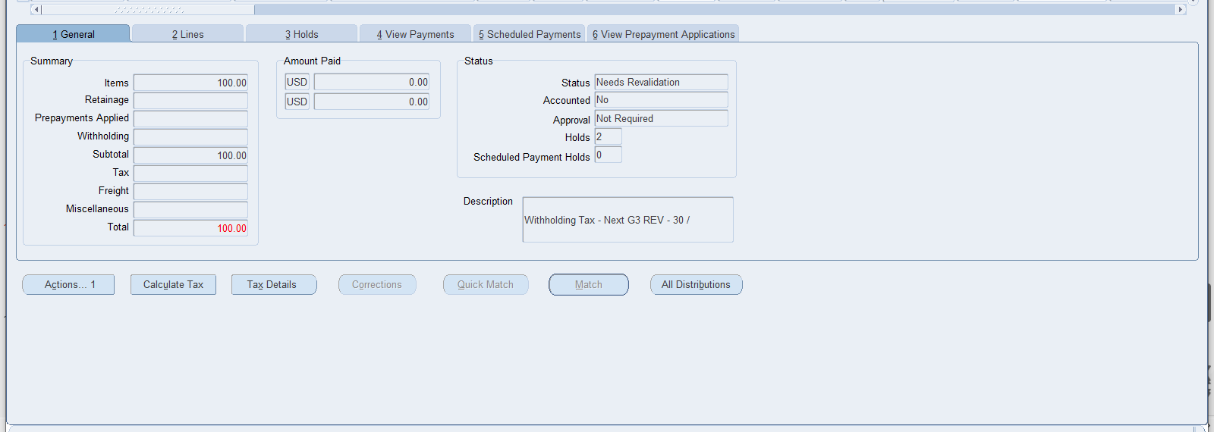
Invoice Validation
If there is some thing wrong, invoice status changes to need revalidation and gives you the issue in
hold window for an example (lines does not equal invoice amount, lines does not have an account or distribution set)
If everything is ok the status changes to validated

Slide 27
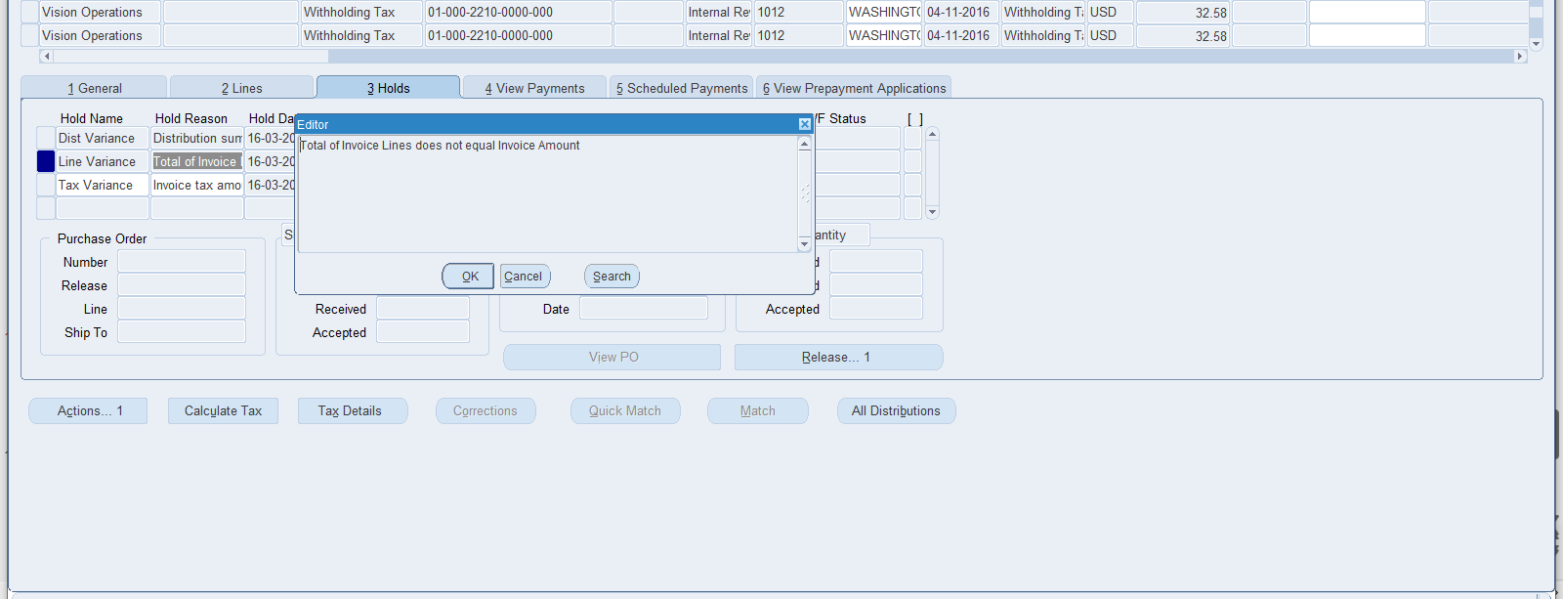
Invoice Validation
If there is some thing wrong, invoice status changes to need revalidation and gives you the issue in
hold window for an example (lines does not equal invoice amount, lines does not have an account or distribution set)
If everything is ok the status changes to validated

Slide 28
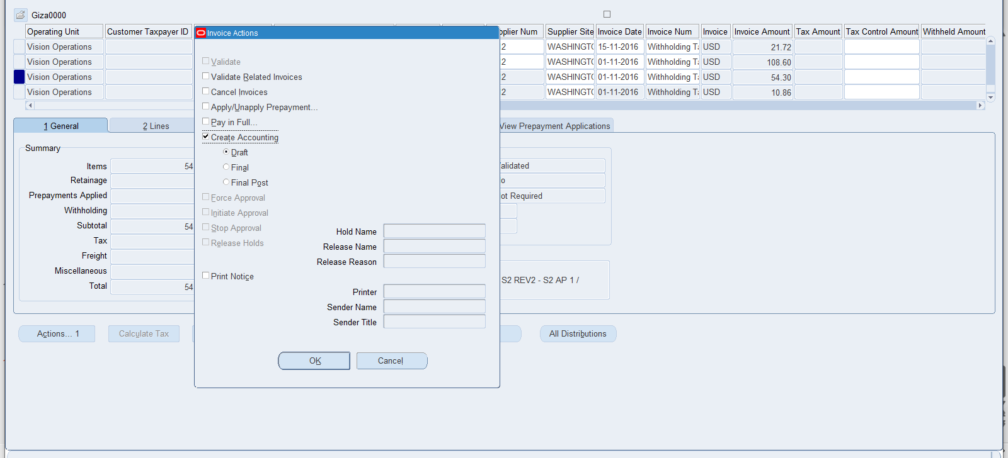
Create accounting
Create accounting

Slide 29
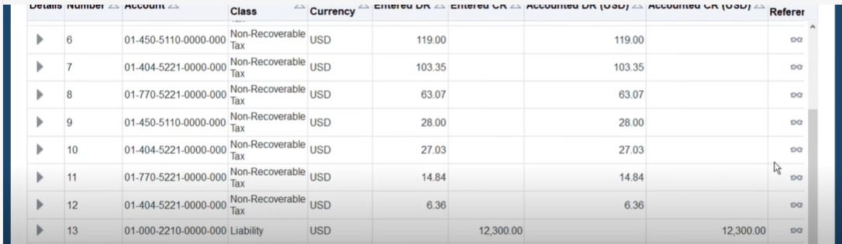
Create accounting
Create accounting

Slide 30

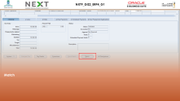

1.
4
1
3
2
Create Invoice
2.
PO Matching
Content
PO
Matching
Create Invoice
Payments
Reports
3.
Payments
4.
Reports

Slide 31
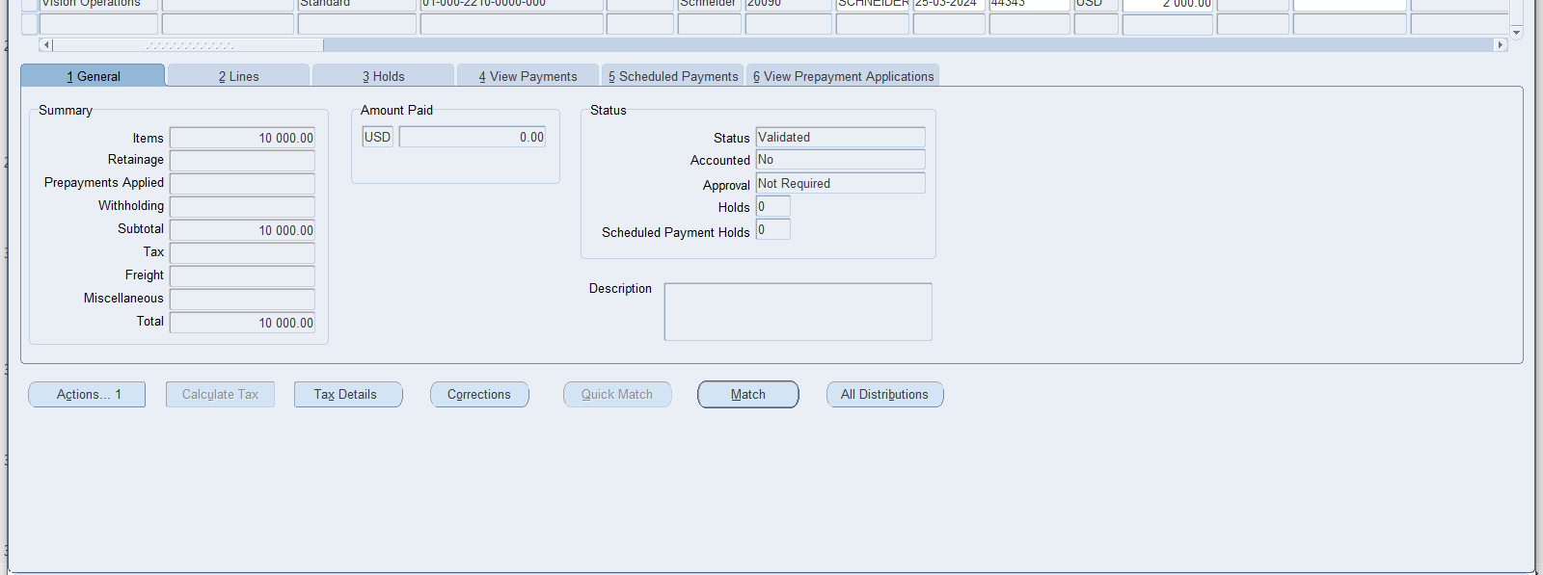
Match

Slide 32
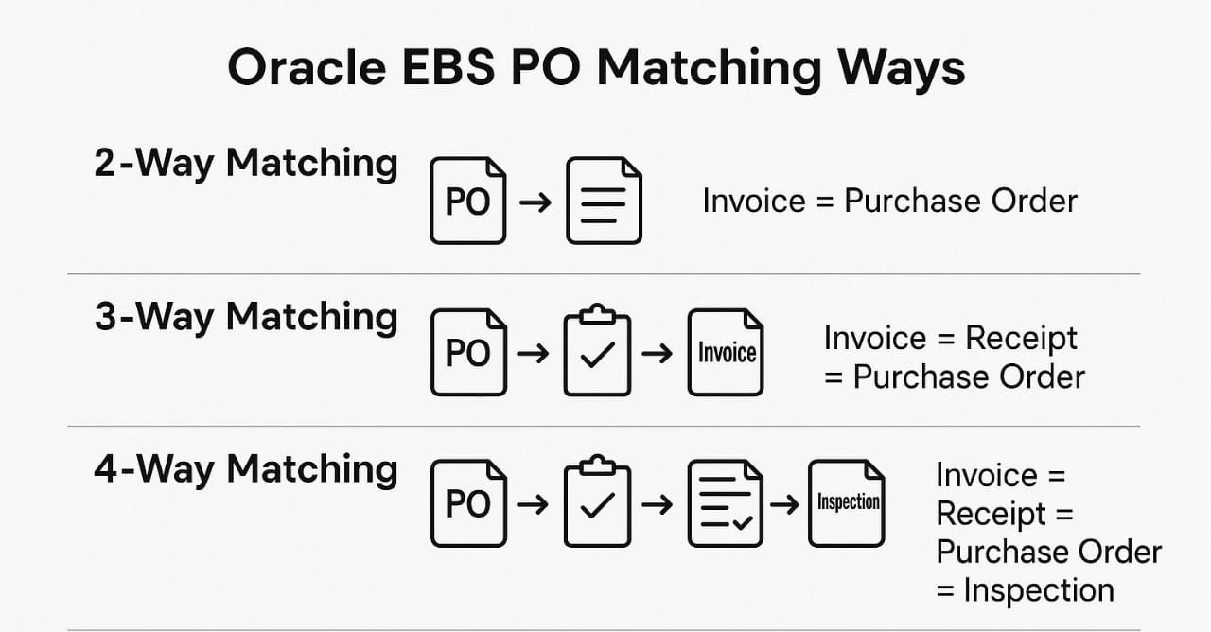
Match Ways

Slide 33
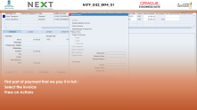
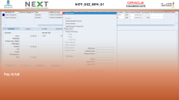
1.
4
1
3
2
Create Invoice
2.
PO Matching
Content
PO
Matching
Create Invoice
Payments
Reports
3.
Payments
4.
Reports

Slide 34
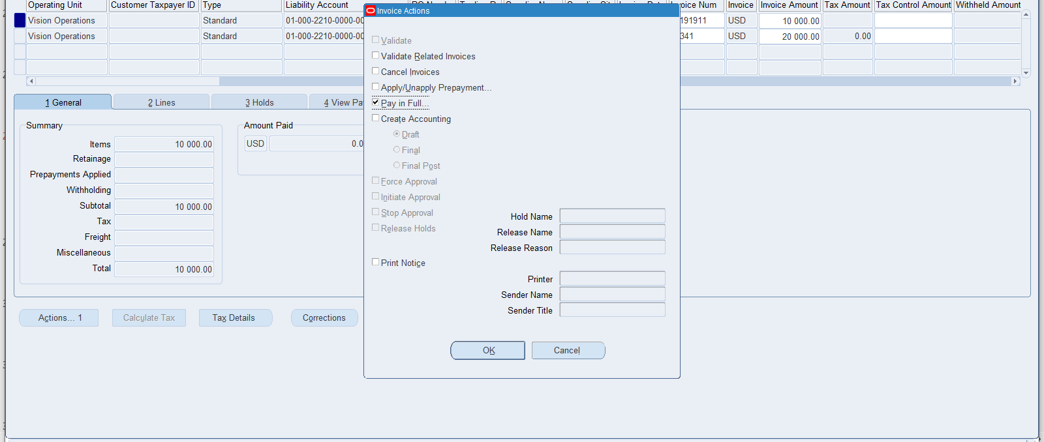
First part of payment that we pay it in full :
Select the invoice
Press on Actions

Slide 35
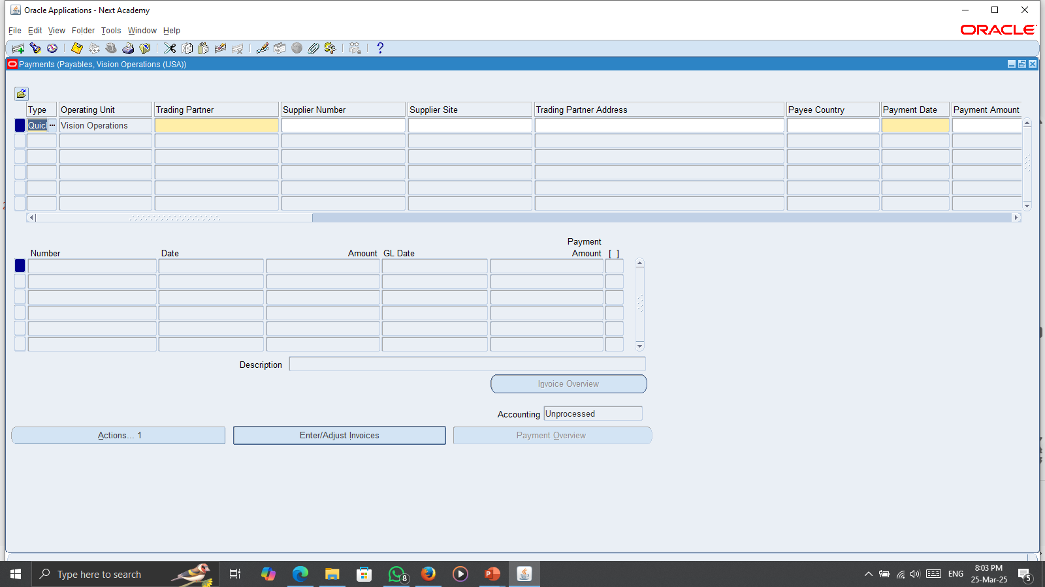
Payments Screen

Slide 36
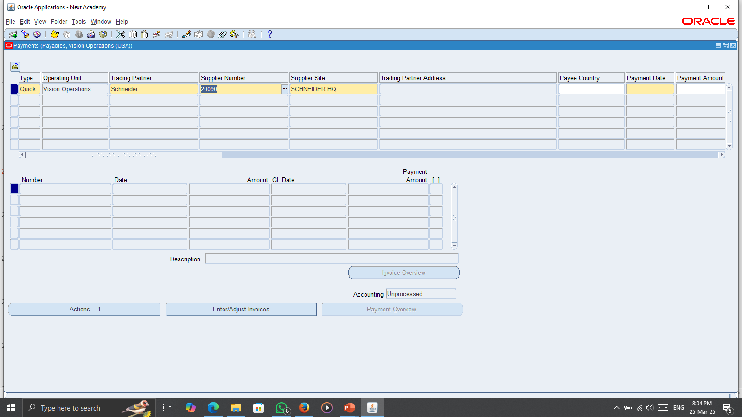
Fill the trading partner or Supplier Number and Supplier Site

Slide 37
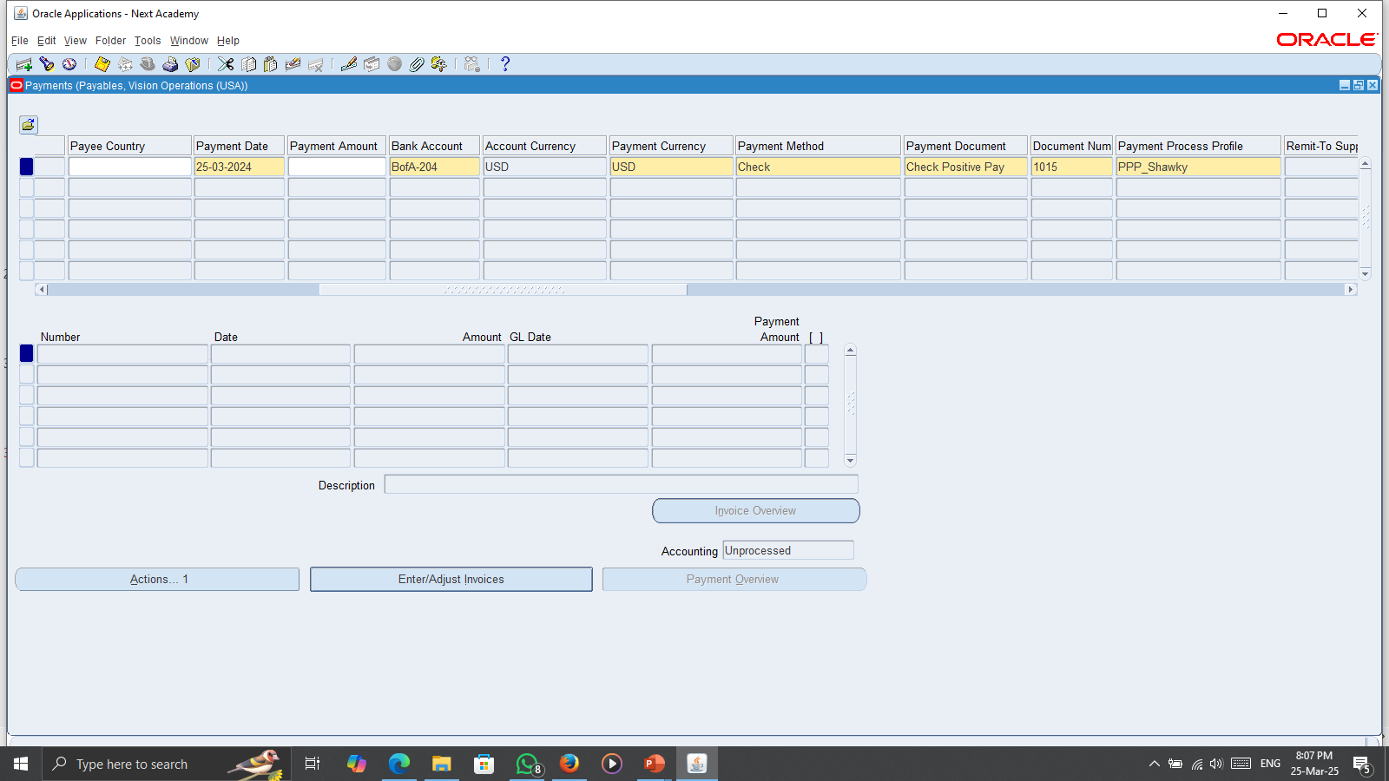
Fill the required fields

Slide 38
Enter/Adjust Invoices

Slide 39
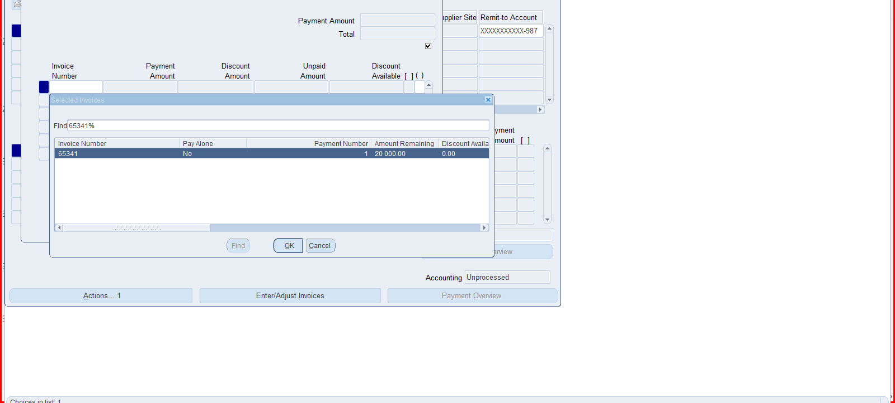
Choose the invoice

Slide 40
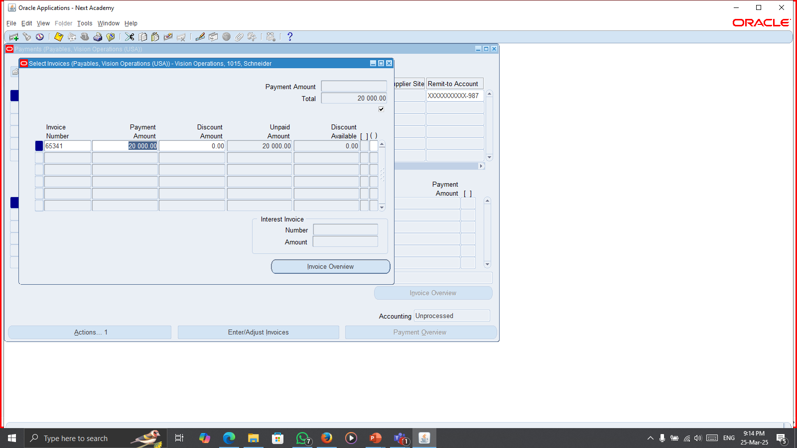
Choose the invoice

Slide 41
Actions

Slide 42
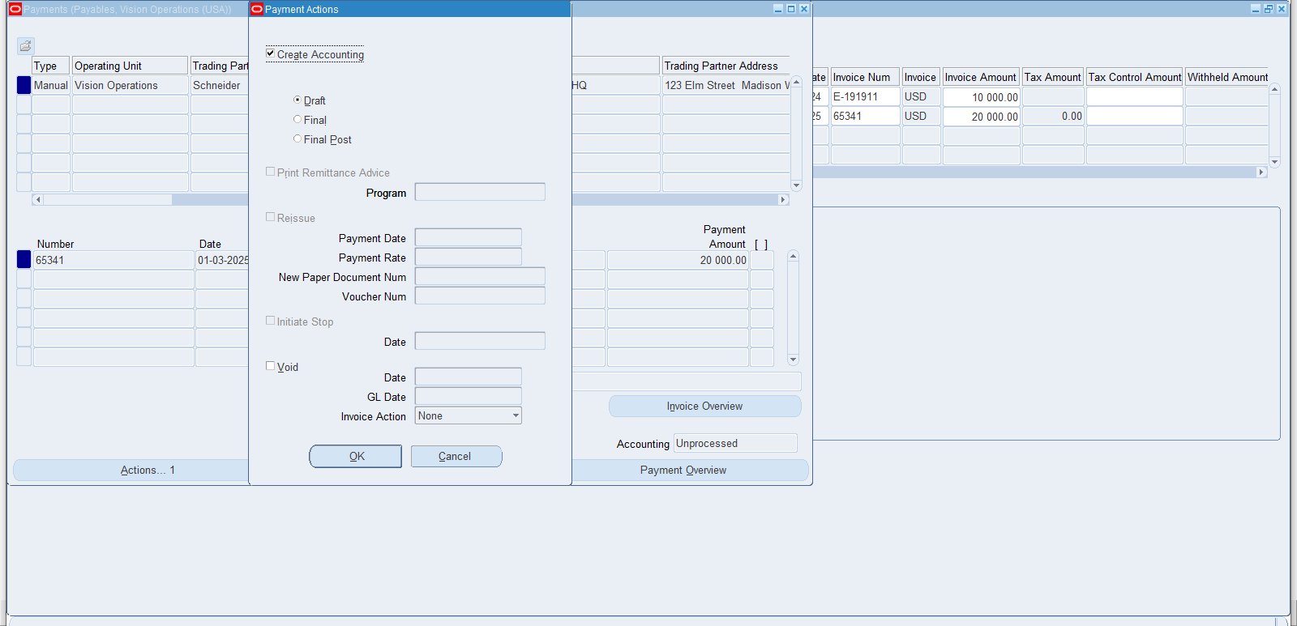
Create Accounting

Slide 43
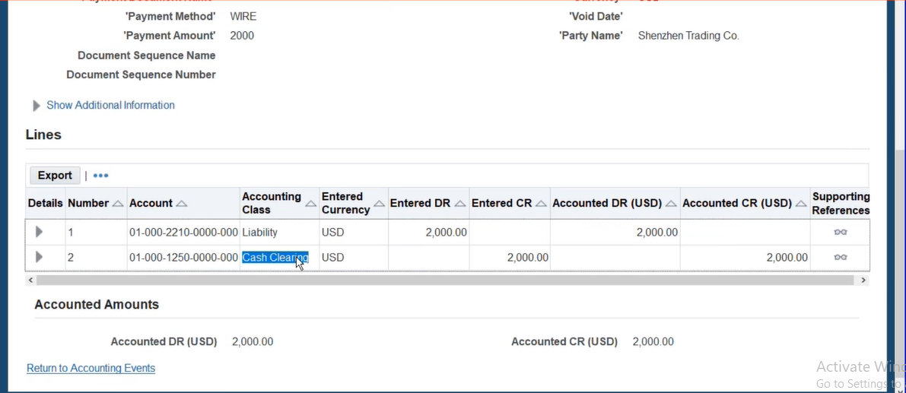
DR/ Liability CR/ cash clearing

Slide 44
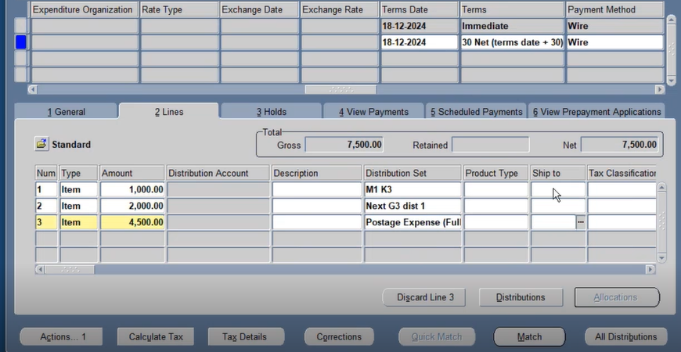
-After writing the invoice data we press on Actions

Slide 45
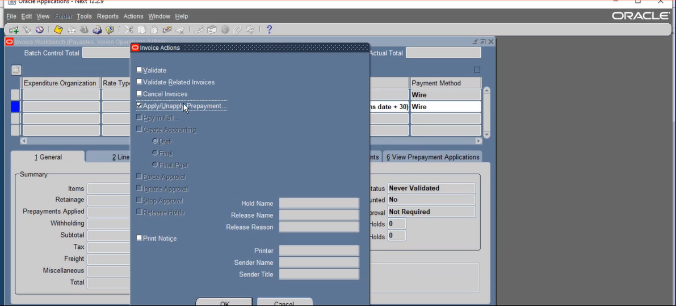
Click on apply

Slide 46
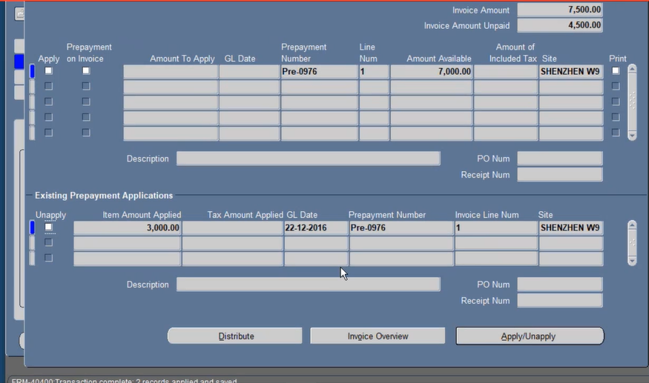
After writing the amount press on save and after it became applied we go on action again
and validate it the press o create accounting

Slide 47
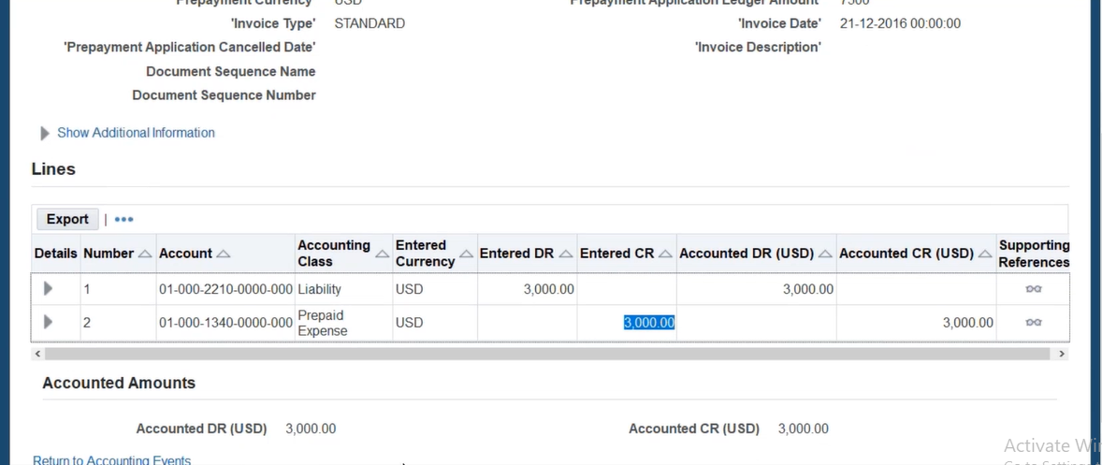
liability dr Prepaid expense cr

Slide 48
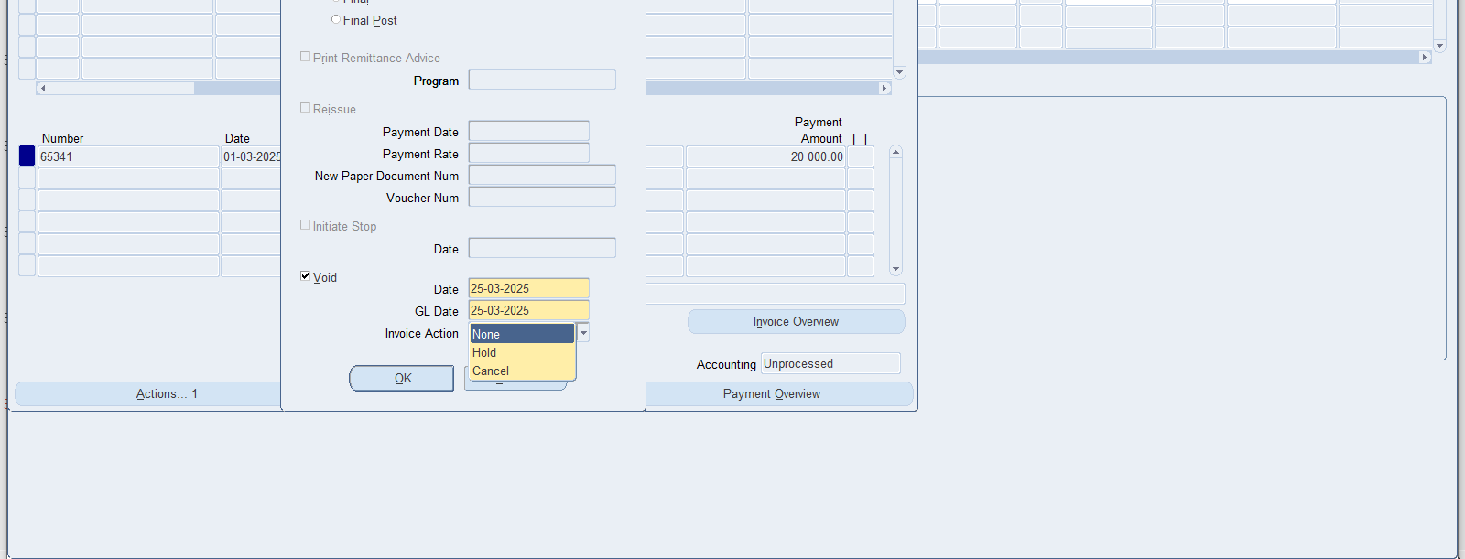
Void

Slide 49
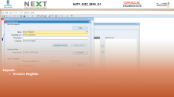
1.
4
1
3
2
Create Invoice
2.
PO Matching
Content
PO
Matching
Create Invoice
Payments
Reports
3.
Payments
4.
Reports

Slide 50
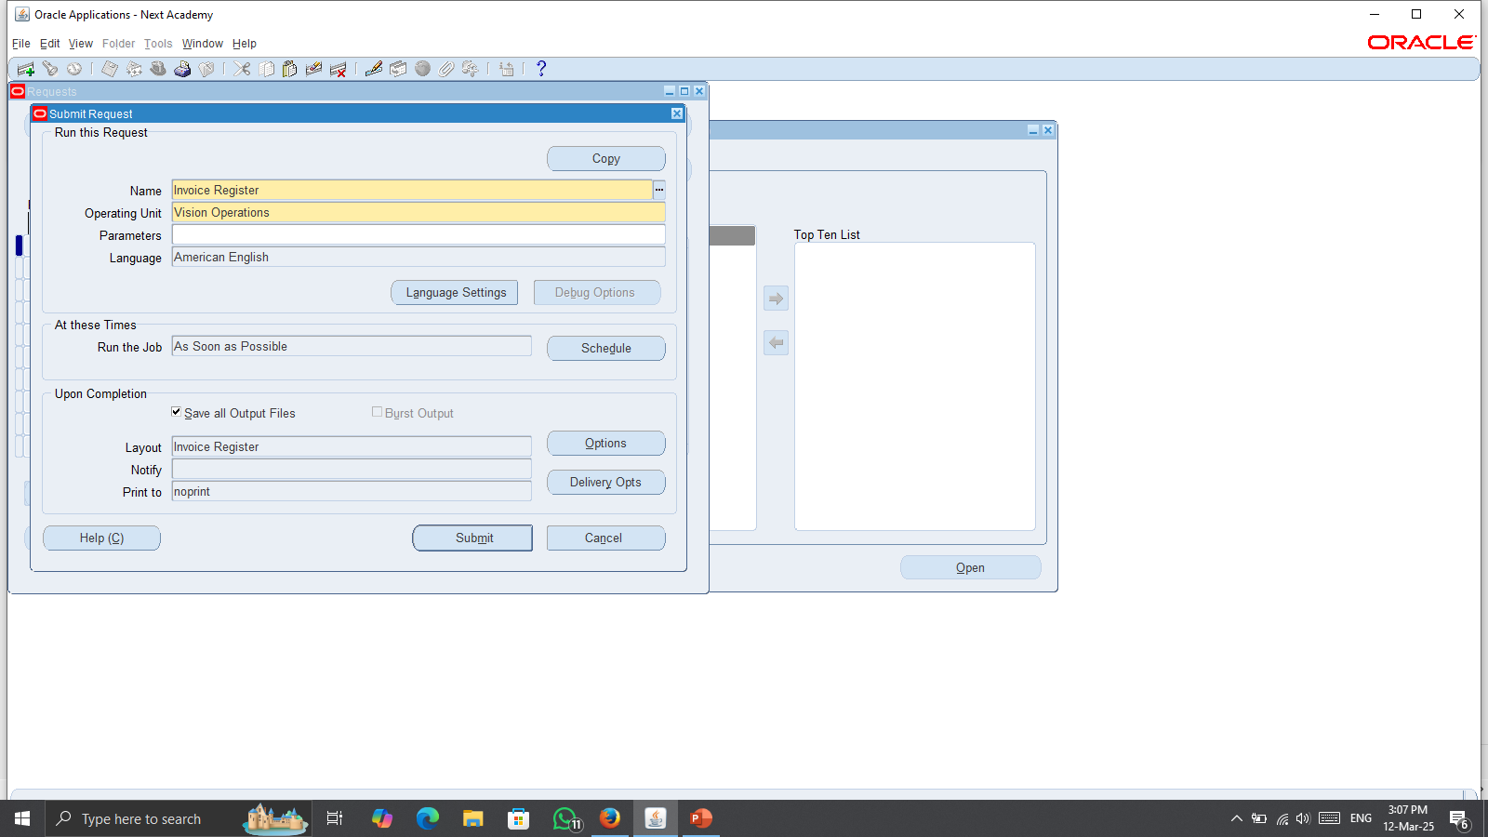
Reports:
Invoice Register

Slide 51
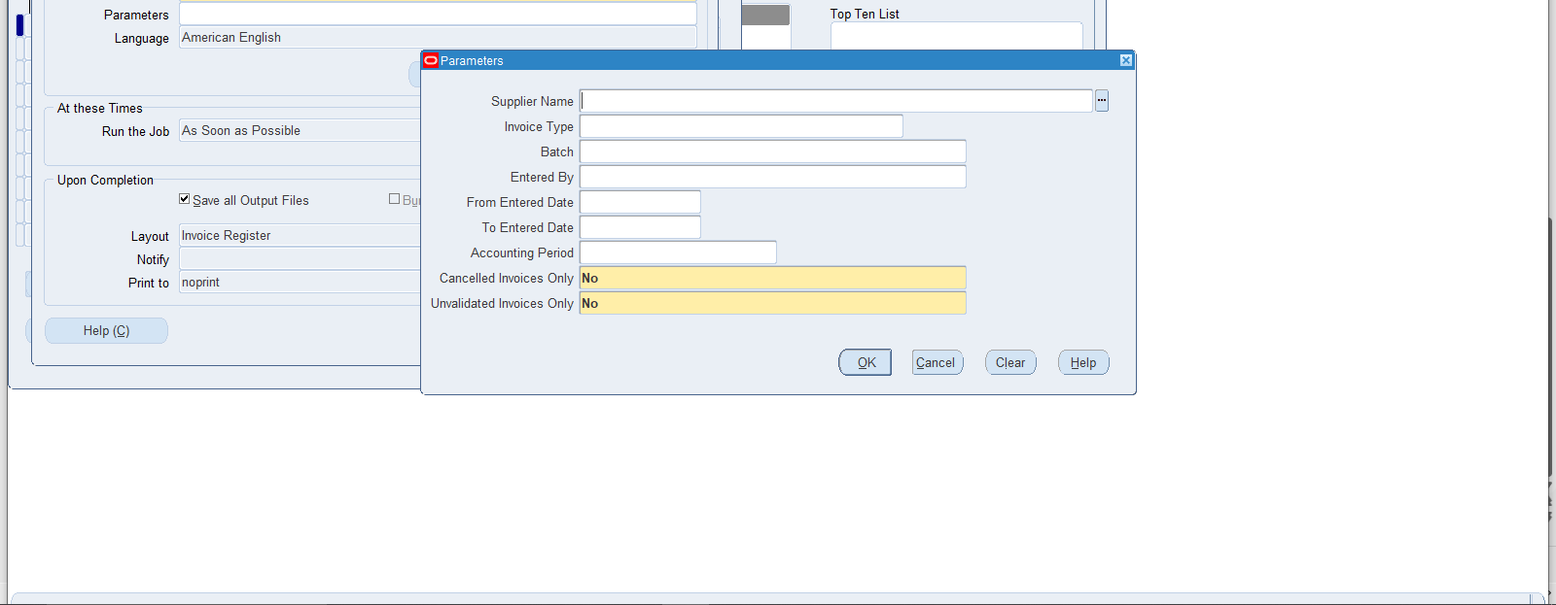
Fill the Parameters

Slide 52
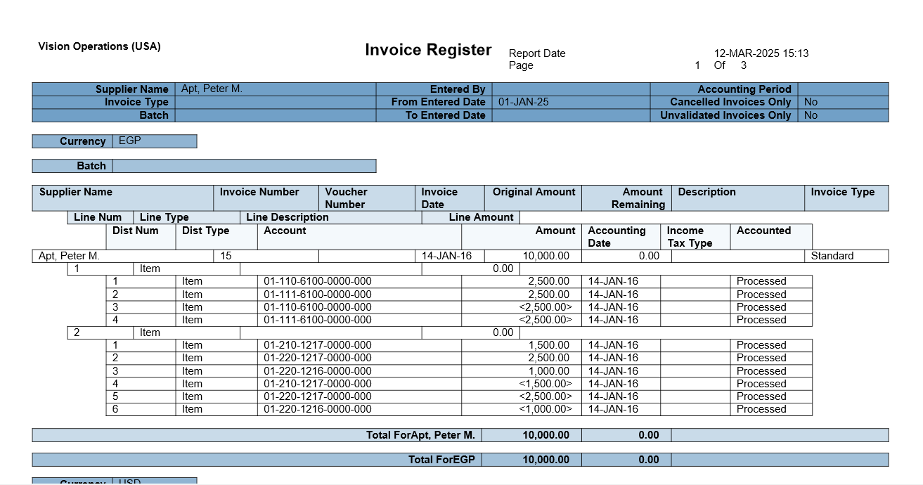
Invoice Register Report

Slide 53
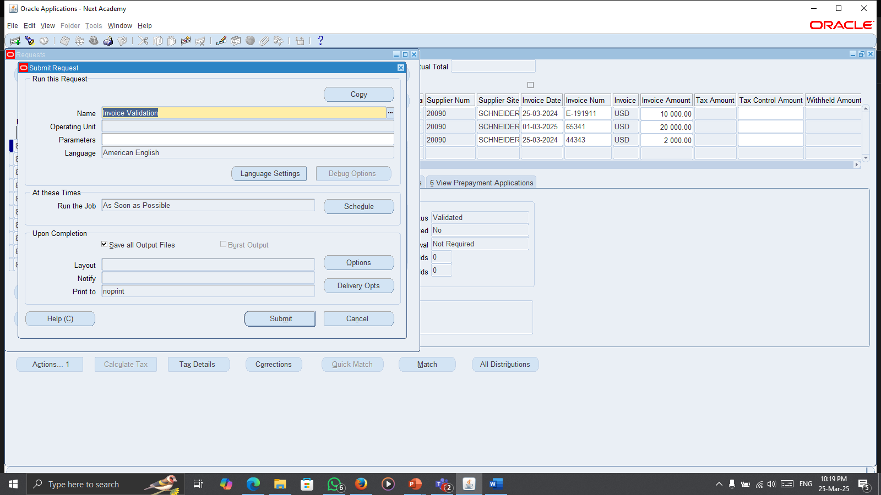
Reports:
Invoice Validation

Slide 54
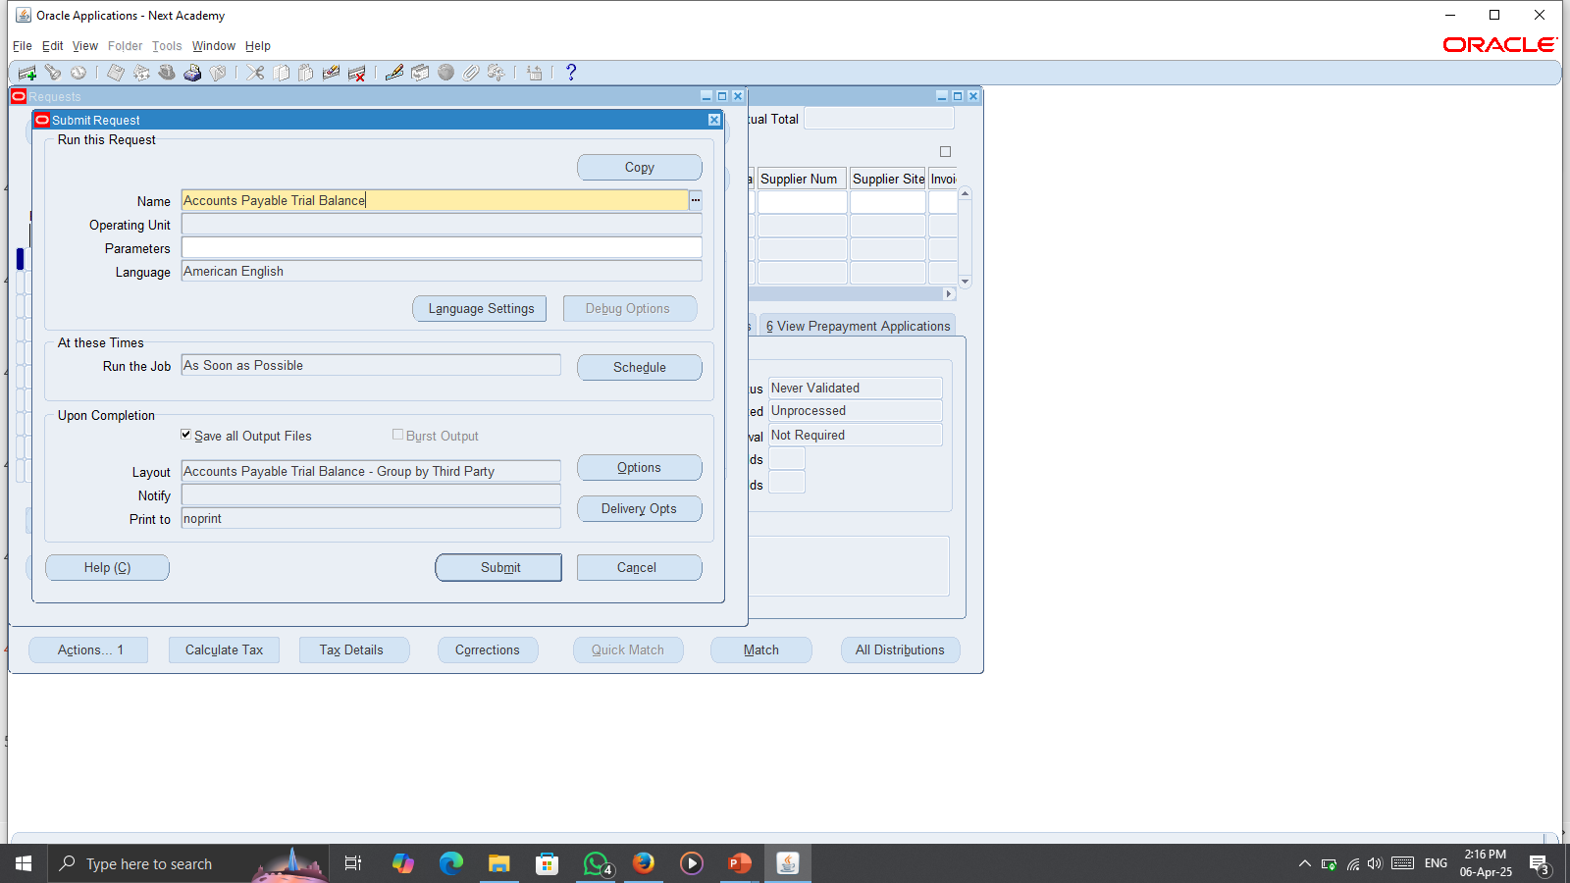
Reports:
Trial Balance

Slide 55
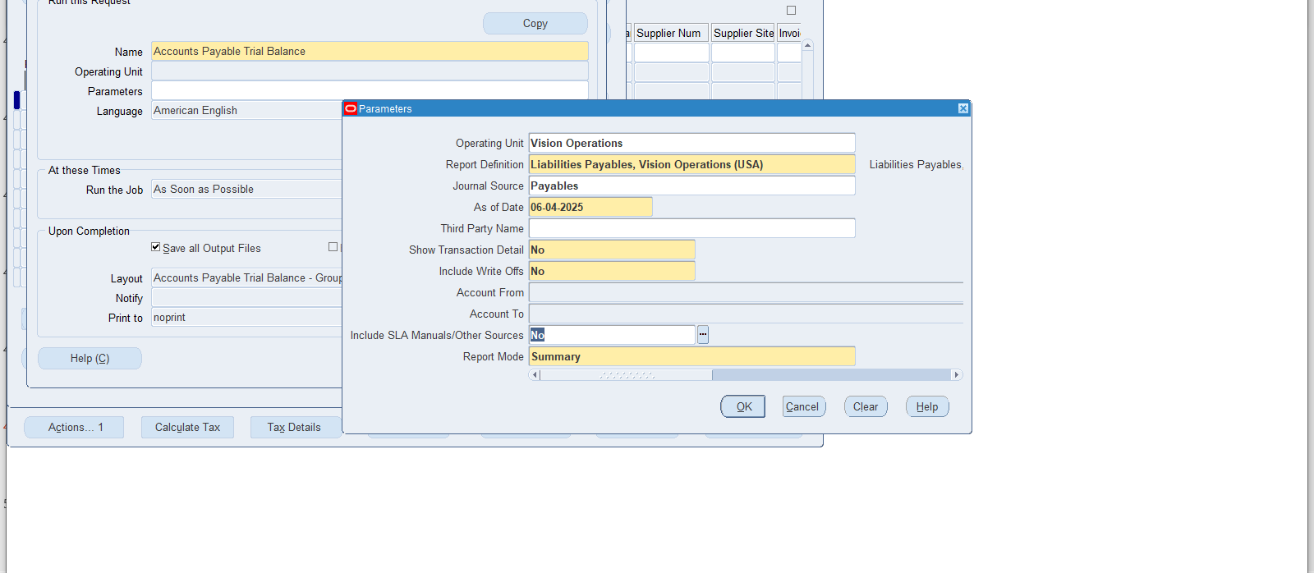
Fill the Parameters

Slide 56
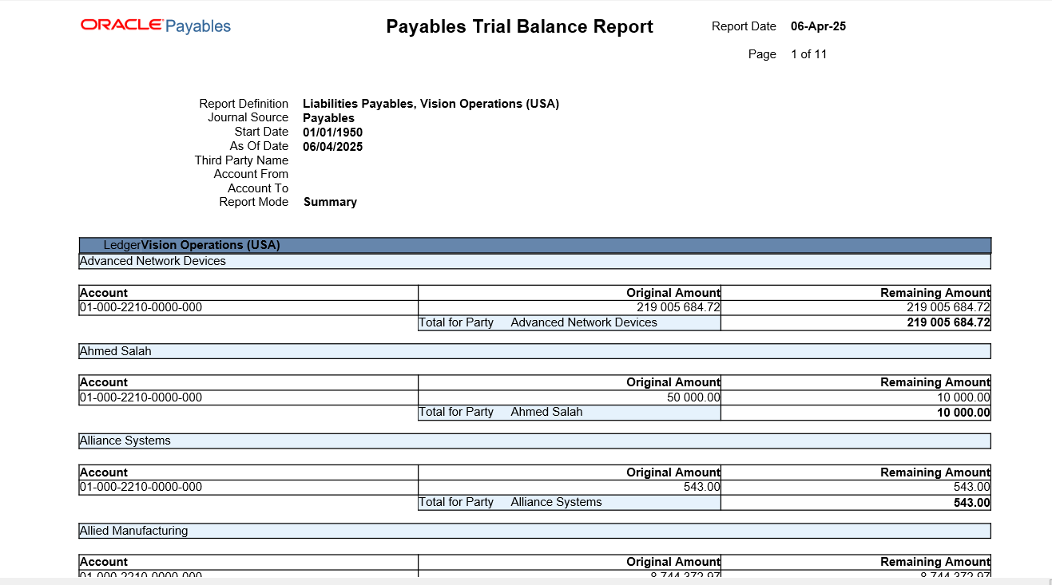
Trial Balance Report

Slide 57
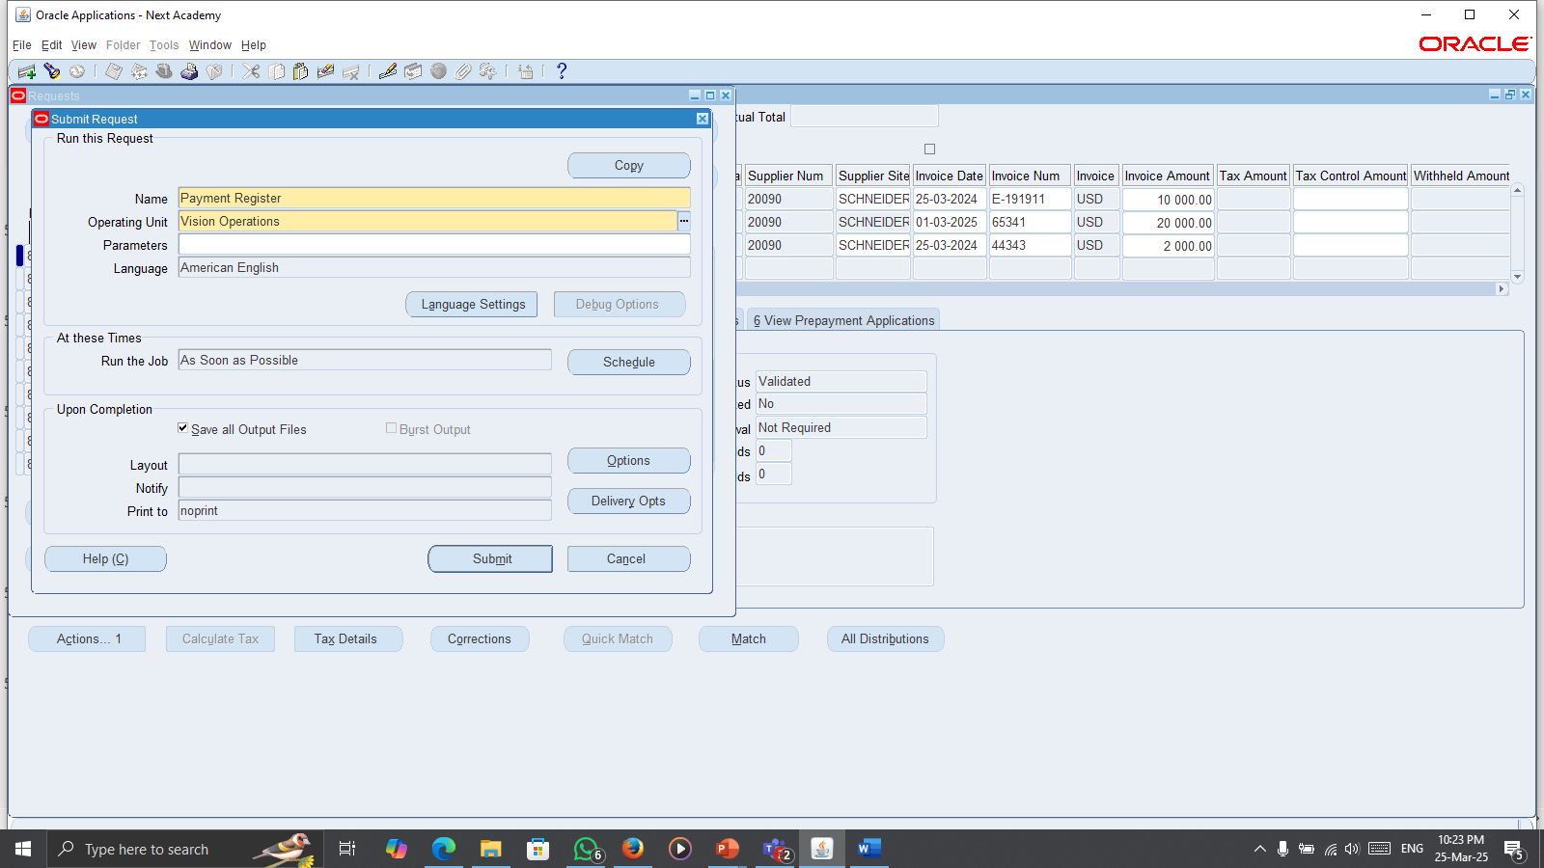
Reports:
Payment Register

Slide 58
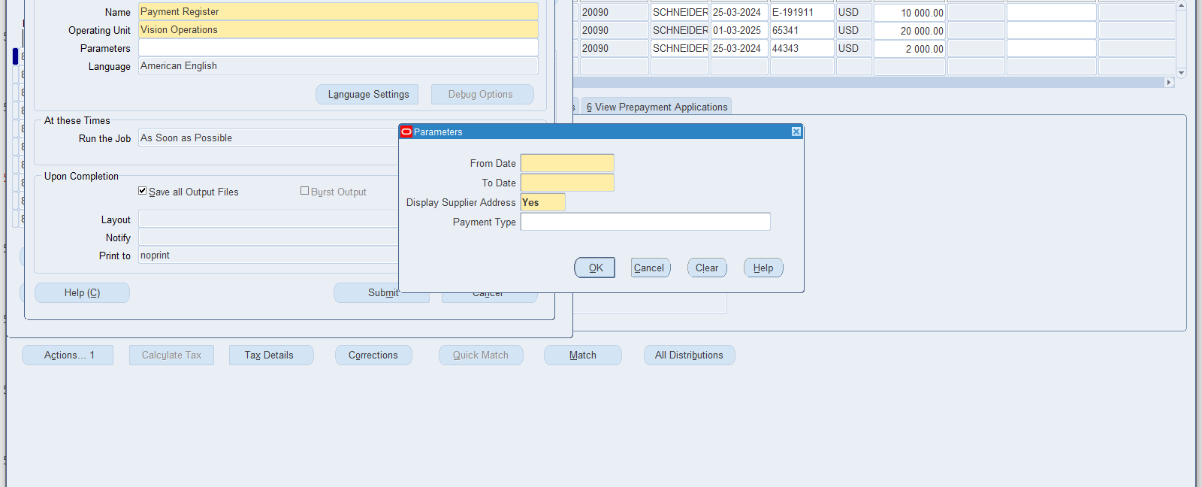
Fill the Parameters

Slide 59
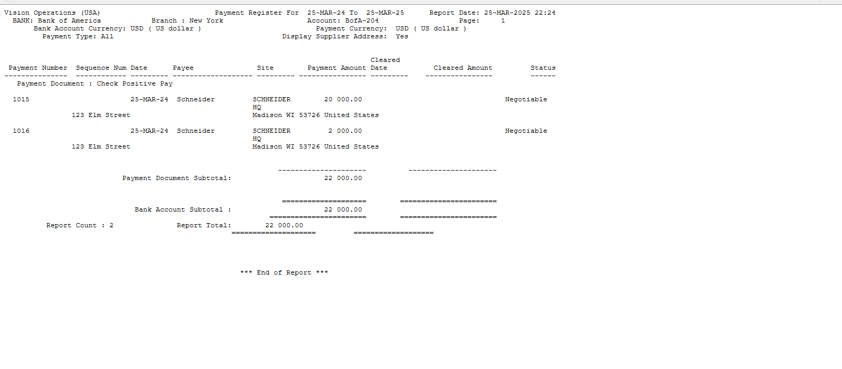
Payment Register Report

Slide 60
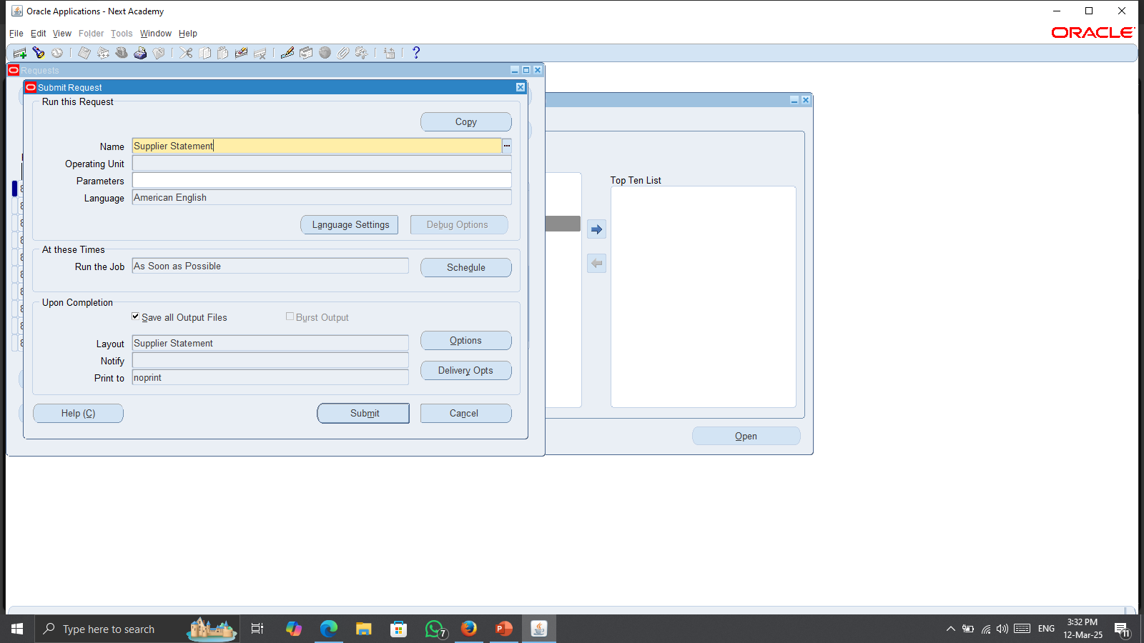
Reports:
Supplier Statement Report

Slide 61
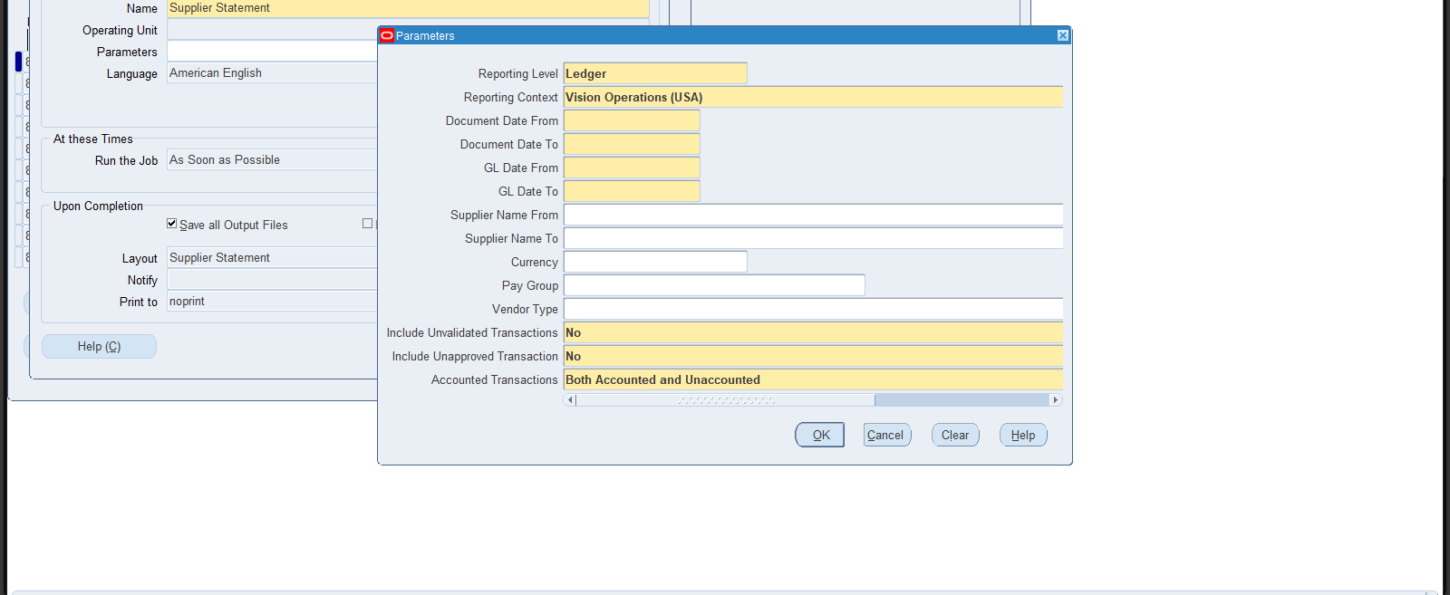
Fill the Parameters

Slide 62
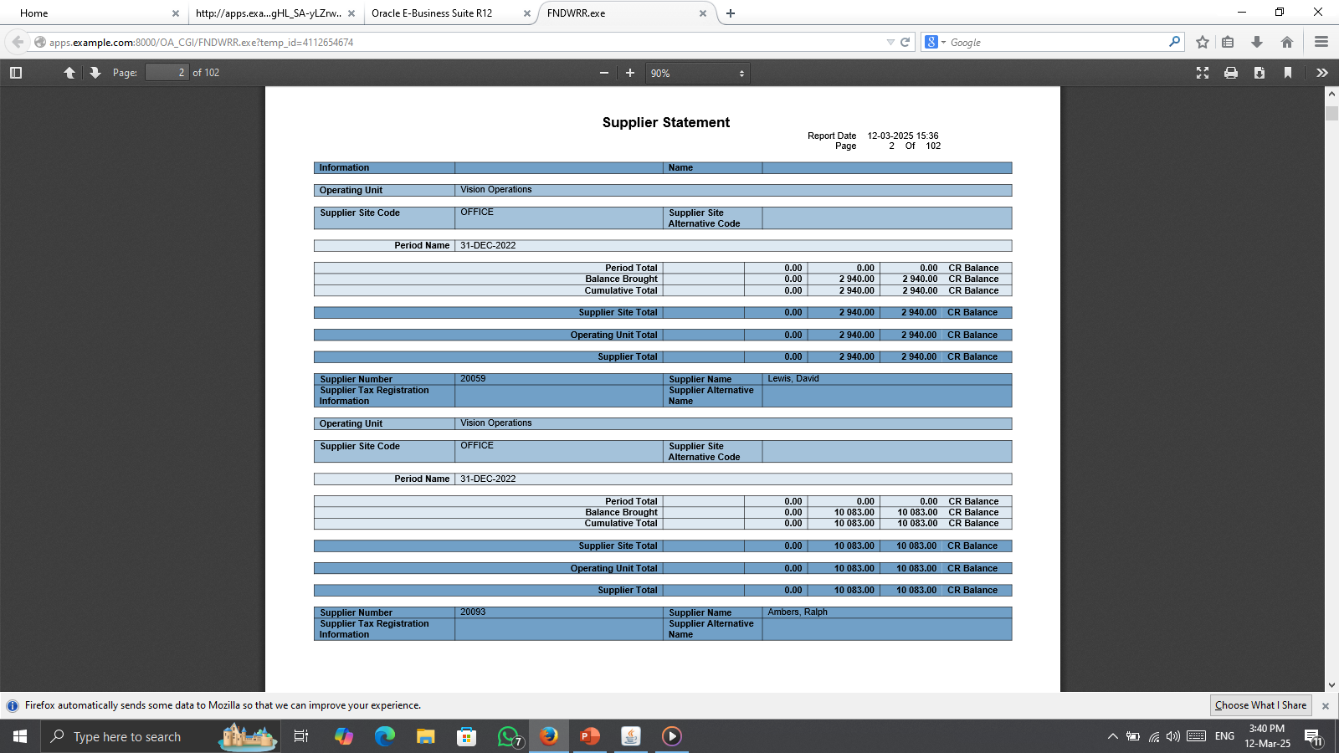
Supplier Statement Report

Slide 63

Reports:
Update Matured Bills Payable Status

Slide 64
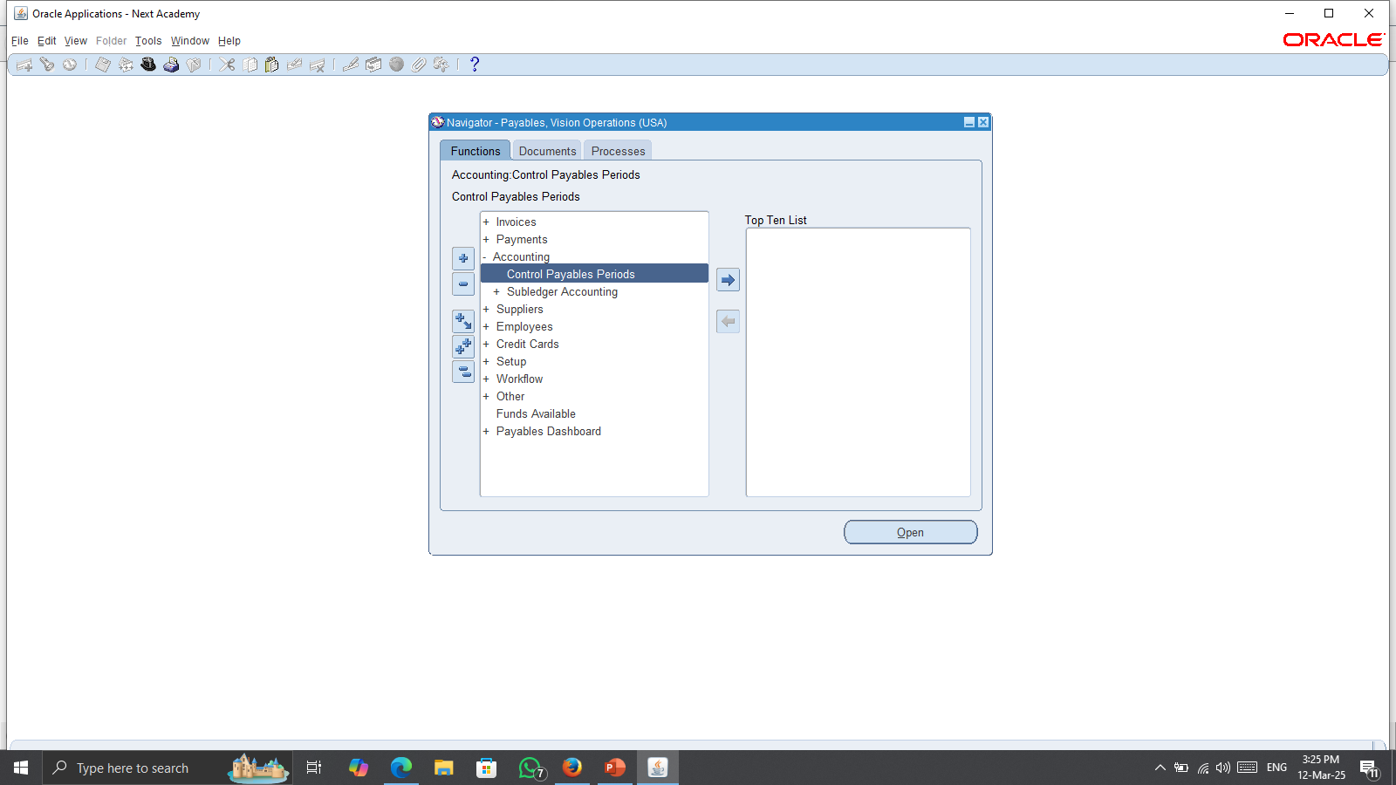
Cloes Period:
Accounting > Control Payable Periods

Slide 65
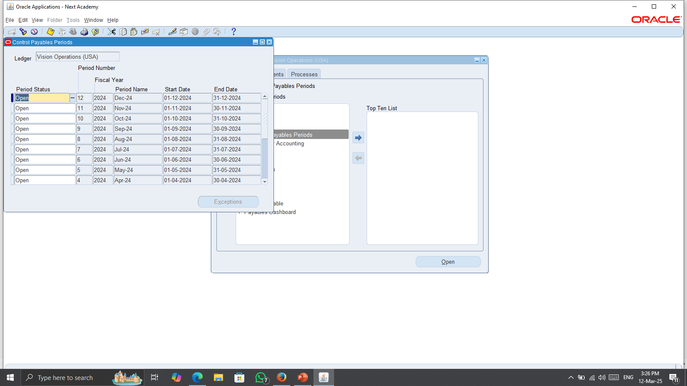
Cloes Period:
Select the period

Slide 66
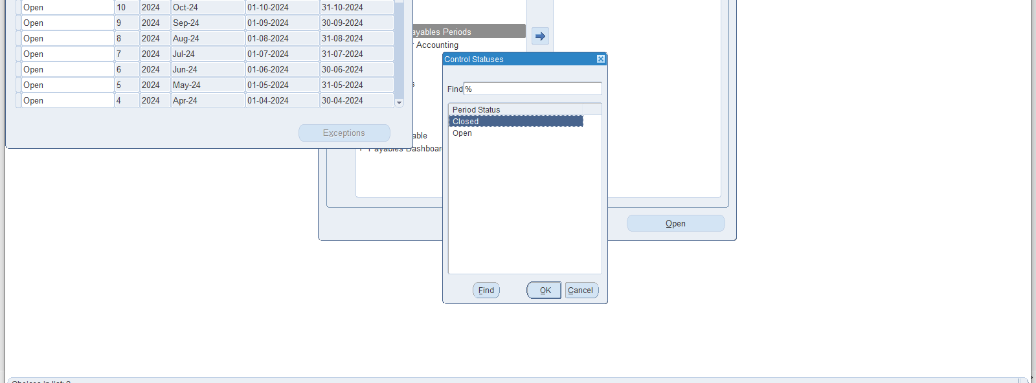
Cloes Period:
Change the Period Status to Closed

Slide 67
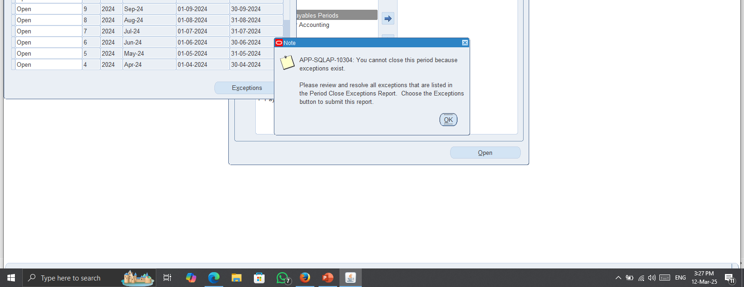
Cloes Period:
Change the Period Status to Closed

Slide 68

Report:
Subledger Period Close Exception Report

Slide 69

Fill the Parameters

Slide 70

Subledger Period Close Exception Report

Slide 71
Q/A

Slide 72
Thanks

